Slide 1
Chapter15 Debt and Taxes
報告日：2019 年 11 月 26 日
報告人：吳佩軒、楊佳綺、陳庭、洪薏珊
指導老師：王甡

Slide 2
OUTLINE
15.1 ….. The Interest Tax Deduction
15.2 ….. Valuing the Interest Tax Shield
15.3 ….. Recapitalizing to Capture the Tax Shield
15.4 ….. Personal Taxes
15.5 ….. Optimal Capital Structure with Taxes

Slide 3
15.1 The Interest Tax Deduction

Slide 4
The Interest Tax Deduction
Corporations must pay taxes on the income that they earn.
They pay taxes on their profits after interest payments are deducted.
Thus, interest expense reduces the amount of corporate taxes.

Slide 5
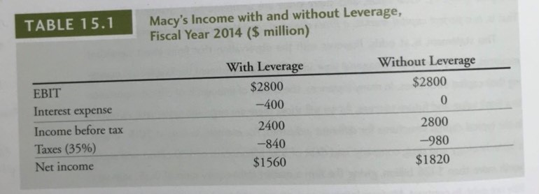
The Interest Tax Deduction
Example: Consider Macy’s Inc., a retail department store.
Macy had earnings before interest and taxes of approximately $2.8 billion (EBIT) in 2014, and interest expenses of about $400 million.
Given Macy’s marginal corporate tax rate of 35%.
WHATS IS LEVERAGE?
WHY LEVERAGE?

Slide 6
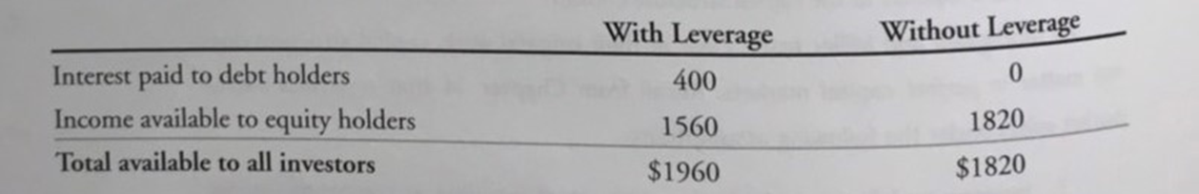

The Interest Tax Deduction
Macy’s net income in 2014 was lower with leverage than it would have been without leverage.
Macy’s debt obligations reduced the value of its equity. But the total amount available to all investors was higher with leverage (400+1560=1960>1820).
Where does the additional $140 million come from?

Slide 7

Interest Tax Shield
The Interest Tax Shield is the reduction in taxes paid due to the tax deductibility of interest.

Slide 8
Interest Tax Shield
Where does the additional $140 million come from?
In Macy’s case, the gain is equal to the reduction in taxes with leverage:
– Look: $980 million − $840 million = $140 million.
– The interest payments provided a tax savings of 35% × $400 million = $140 million.

Slide 9
15.2 Valuing the Interest Tax Shield

Slide 10
The Interest Tax Shield and Firm Value
When a firm uses debt, interest tax shield provides a corporate tax benefit each year.
The benefit of leverage for the value of the firm, of the firm, we must computer the present value of the stream of future interest tax shields the firm will receive.

Slide 11
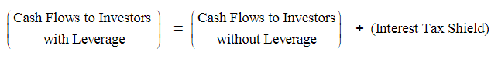
The cash flows it pays to investors will be higher than they would be without leverage by the amount of the interest tax shield:

Slide 12
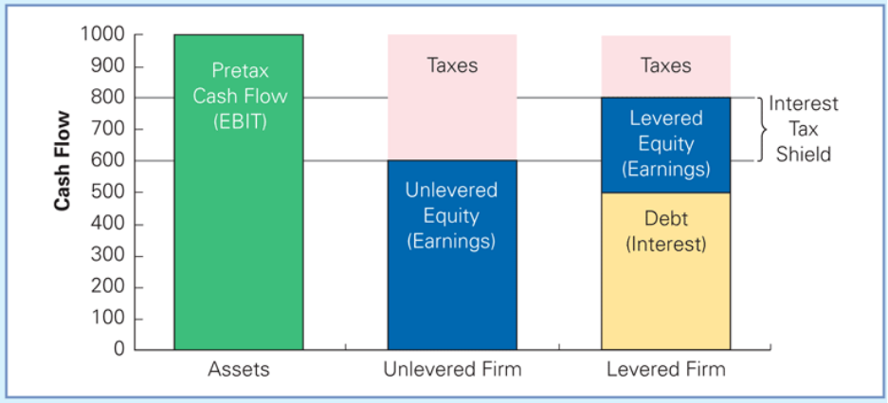
Figure 15.1 The Cash Flows of the Unlevered and Levered Firm
 | Without Leverage | With Leverage
EBIT | 1000 | 1000
Interest expense | 0 | -500
Income before tax | 1000 | 500
Taxes (40%) | -400 | -200
Net income | 600 | 800

Slide 13
MM Proposition I with Taxes
The total value of the levered firm exceeds the of the firm without leverage due to the present value of the tax savings from debt:
$$\left.V^{L}=V^{U}+PV(Interest Tax Shield\right)$$

Slide 14
Pizza and Taxes
Pizza and Taxes In Chapter 14, we mentioned the pizza analogy that Merton Miller once used to describe the MM Propositions with perfect capital markets: No matter how you slice it, you still have the same amount of pizza. We can extend this analogy to the setting with taxes, but the story is a bit different. In this case, every time equity holders get a slice of pizza, Uncle Sam gets a slice as a tax payment.
But when debt holders get a slice, there is no tax. Thus, by allocating more slices to debt holders rather than to equity holders, more pizza will be available to investors. While the total amount of pizza does not change, there is more pizza left| over for investors to consume because less pizza is consumed by Uncle Sam in taxes.

Slide 15
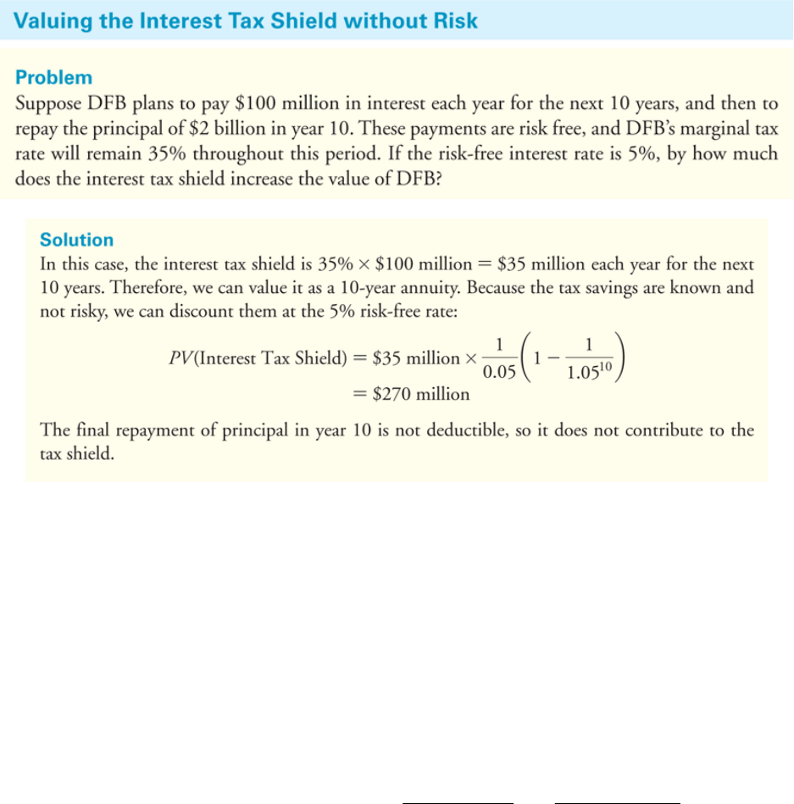
Textbook Example 15.2

Slide 16
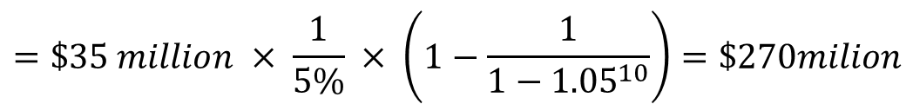
Textbook Example 15.2
Interest Payments
Tax Rate
$$Interest shield=\$100 million × 35\% =\$35million$$
$PV\left(Interest shield\right)=A\frac{1−{\left(1+i\right)}^{−n}}{i}=A×\frac{1}{i}×\left(1−\frac{1}{1−{\left(1+i\right)}^{n}}\right)$
$$=\$35 million × \frac{1}{5\%} × \left(1−\frac{1}{1−{1.05}^{10}}\right)=\$270milion$$

Slide 17
The Interest Tax Shield with Permanent Debt
Typically, the level of future interest payments varies due to ：
Changes the firm makes in the amount of debt outstanding
Changes in the interest rate on that debt
The risk that the firm may default and fail to make an interest payments
The firm's marginal tax rate may fluctuate due to changes in the tax code and changes in the firm's income bracket
Let's consider the special case in which the firm issues debt and plans to keep the dollar amount of debt constant forever.

Slide 18
For example, the firm might issue a perpetual consol bond, making only interest payments but never repaying the principal.
More realistically, suppose the firm issues short-term debt, such as a five-year coupon.
When the principal is due , the firm raises the money needed to pay it by issuing new debt.
the firm never pays off the principal but simply refinances it whenever it comes due
the debt is effectively permanent.

Slide 19
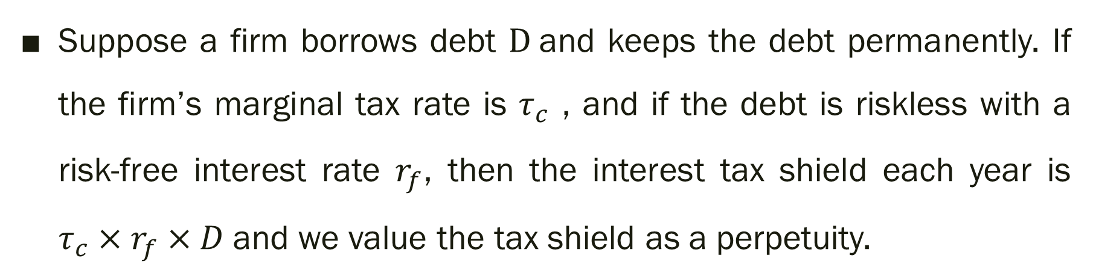
Suppose a firm borrows debt $D$and keeps the debt permanently. If the firm’s marginal tax rate is $τ_{c}$ , and if the debt is riskless with a risk-free interest rate $r_{f}$, then the interest tax shield each year is $τ_{c}×r_{f}×D$and we value the tax shield as a perpetuity.
$$PV\left(Inerest shield\right)= \frac{τ_{c}×\text{Interest} \text{expense} }{r_{f}}$$
$$=\frac{τ_{c}×r_{f}×D}{r_{f}}$$
$$=τ_{c}×D$$

Slide 20
As long as the debt is fairly priced, no arbitrage implies that its market value must equal the present value of the future interest payments:
$$Market Value of Debt =D=PV(Future Insterest Payments)$$

Slide 21
If the firm's marginal tax rate is constant, then we have the following general formula:
$$PV(Interest Tax Shield)=PV(τ_{c}×Future Insterest Payments)$$
$${=τ}_{C}×PV(Future Insterest Payments)$$
$$=τ_{c}×D$$
This formula shows the magnitude of the interest tax shield. Give a 35% corporate tax rate, it implies that every $1 in new permanent debt firm issues, the value of the increases by $0.35.

Slide 22
The Repatriation Tax : Why Some Cash-Rich Firms Borrow
In April 2013, Apple Inc. borrowed $17 billion in what was then the largest U.S. corporate bond issuance of all time. But why would a firm with over $100 billion in cash on hand need to borrow money? The answer is that while Apple indeed had plenty of cash, the vast majority of that cash was overseas, and bringing it back to the U.S. would trigger a tax liability in excess of 20%, which Apple wanted to avoid.
Apple's situation is not uncommon. When U.S. firms earn profits overseas, those profits are subject to the foreign corporate tax of the country in which they are earned. But if the profits are then "repatriated" by bringing them back to the U.S. rather than investing them abroad, the firm will owe the difference between the foreign tax paid and the U.S. corporate tax rate. Because foreign corporate tax rates are often very low-for example, 12.5% in Ireland versus 35% in the U.S.-this so-called repatriation tax can be a significant cost. Rather than bear this cost, many firms choose to hold the funds abroad in the form of bonds or other marketable securities, and raise the cash they need in the U.S. by issuing bonds domestically. In Apple's case the $17 billion it borrowed was then used to conduct share repurchases.

Slide 23
So, by holding cash overseas and borrowing at home, firms can avoid or at least delay paying additional taxes on their foreign earnings. Many firms have adopted this strategy in recent years: Shown below are the growth in aggregate cash held overseas by all U.S. corporations, as well as the cash holdings and debt outstanding of several.
To encourage firms to invest more at home, Congress enacted a one-time "tax holiday" in 2004, allowing firms to repatriate funds at a reduced cost though the policy failed to have much effect. Recent calls by both Democrats and Republicans for a more permanent change to the tax code to reduce or eliminate this repatriation tax have so far been unsuccessful, but in the meantime firms continue to borrow and delay paying the tax in hopes of such change. versus be firms in 2015.

Slide 24
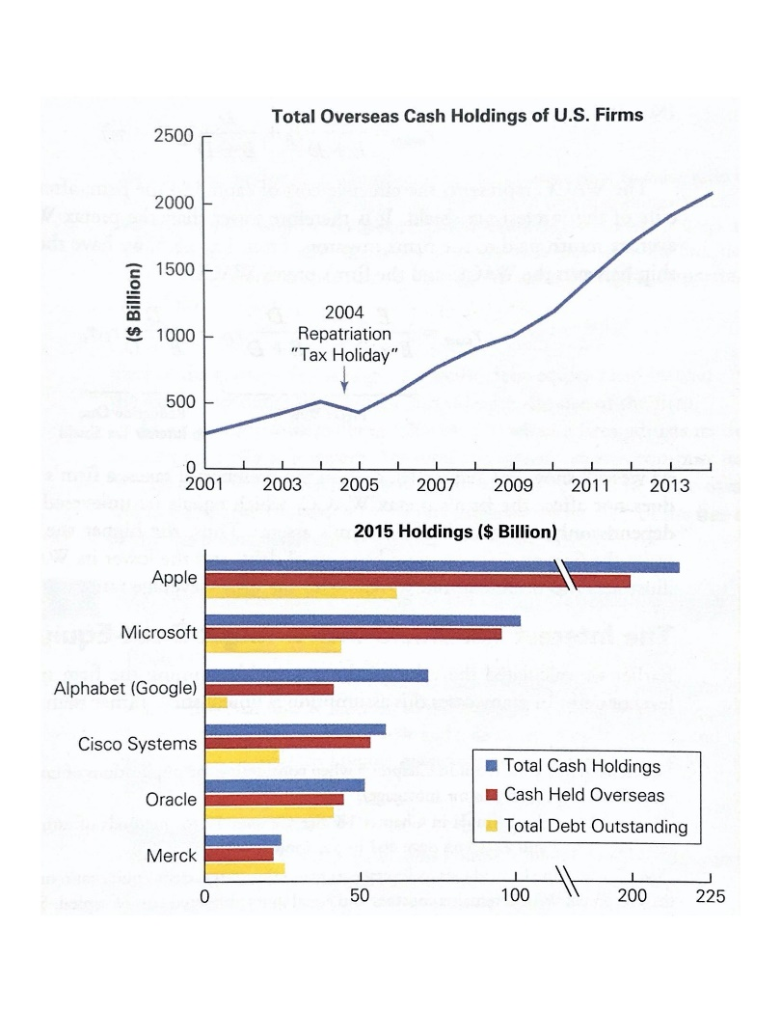

Slide 25
The Weighted Average Cost of Capital with Taxes
The tax benefit of leverage can also be expressed in terms of the weighted average cost of capital.
When a firm uses debt financing, the cost of the interest it must pay is offset to some extent by the tax savings from the interest tax shield.

Slide 26
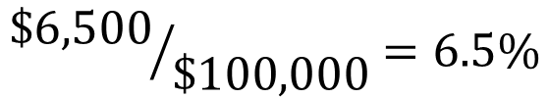
suppose a firm with a 35% tax rate borrows $100,000 at 10% interest per year. Then its net cost at the end of the year is
$$r×D$$
$$τ_{c}×r×D$$
$$Effective after−tax cost of debt=\$10,000+\left(−\$3,500\right)=\$6,500$$
$${\$6,500}/{\$100,000}=6.5\%$$
$$6.5\%≠10\%$$

Slide 27
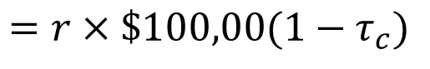
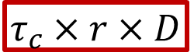
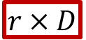
$$r×D$$
$$τ_{c}×r×D$$
$$Effective after−tax cost of debt=(r×\$100,000)+\left(τ_{c}×r×\$100,00\right)$$
$$=r×\$100,00(1−τ_{c})$$
$$the effective after−tax borrowing rate=r×\left(1−τ_{c}\right)$$

Slide 28
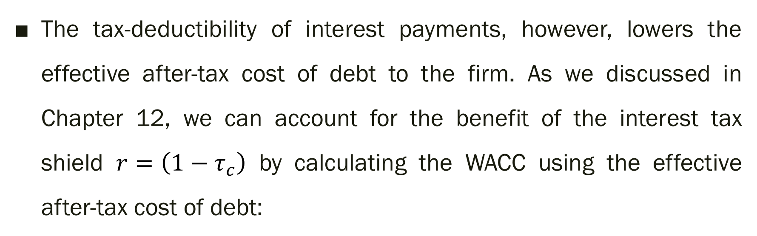
The tax-deductibility of interest payments, however, lowers the effective after-tax cost of debt to the firm. As we discussed in Chapter 12, we can account for the benefit of the interest tax shield $r=\left(1−τ_{c}\right)$ by calculating the WACC using the effective after-tax cost of debt:
$$r_{wacc}=\frac{E}{E+D}r_{E}+\frac{D}{E+D}r_{D}\left(1−τ_{c}\right)$$
$$r_{wacc}=\frac{E}{E+D}r_{E}+\frac{D}{E+D}r_{D}−\frac{D}{E+D}r_{D}τ_{c}$$
Pretax WACC
Reduction Due to Interest Tax Shield

Slide 29
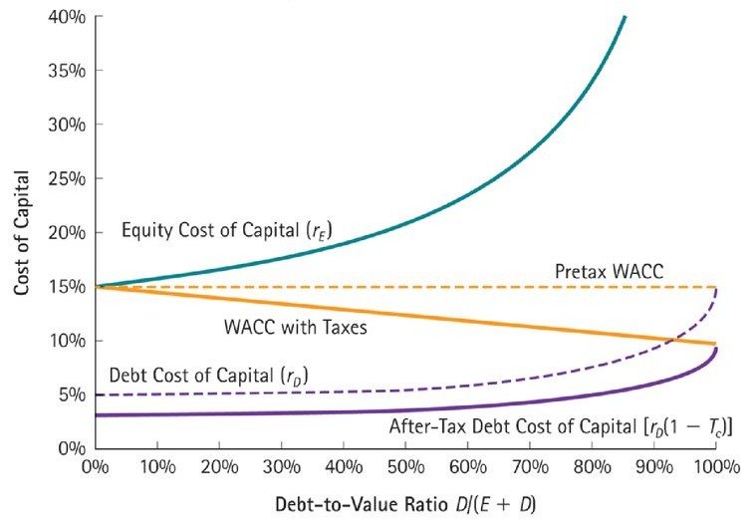
Figure 15.2 The WACC with and without Corporate Taxes
Marginal corporate income tax rate $τ_{c}=35\%$
$$Pretax WACC=\frac{E}{E+D}r_{E}+\frac{D}{E+D}r_{D}$$
$$WACC with Tax=\frac{E}{E+D}r_{E}+\frac{D}{E+D}r_{D}\left(1−τ_{c}\right)$$

Slide 30
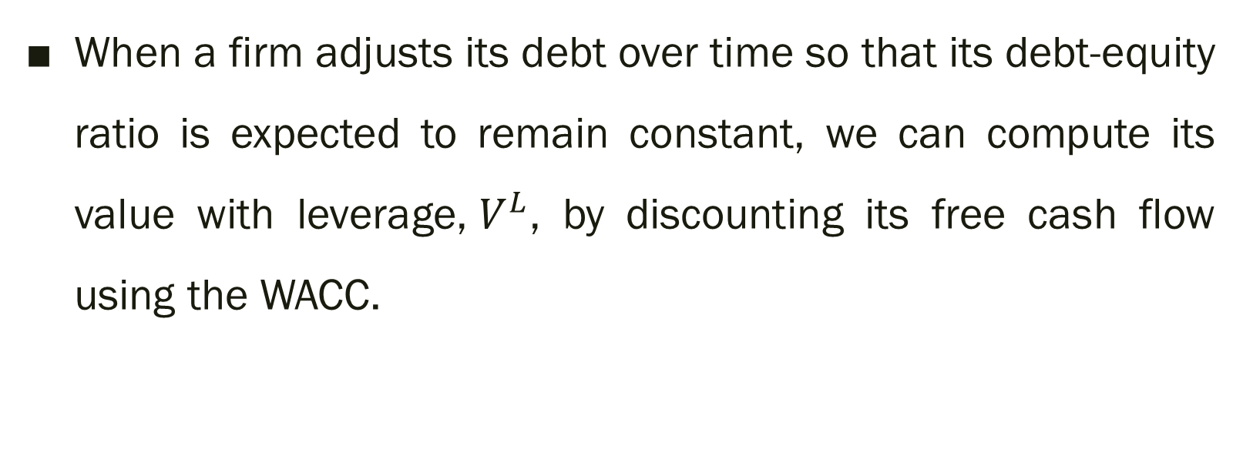
The Interest Tax Shield with a Target Debt-Equity Ratio
When a firm adjusts its debt over time so that its debt-equity ratio is expected to remain constant, we can compute its value with leverage,${ V}^{L}$, by discounting its free cash flow using the WACC.

Slide 31
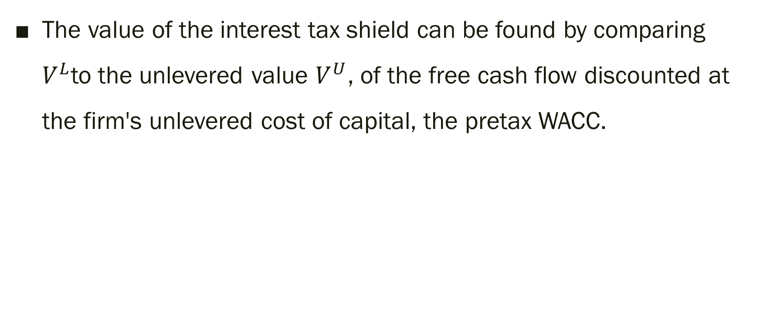
The value of the interest tax shield can be found by comparing $V^{L}$to the unlevered value $V^{U}$, of the free cash flow discounted at the firm's unlevered cost of capital, the pretax WACC.

Slide 32
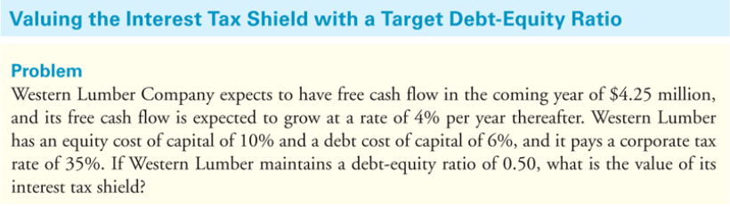
Textbook Example 15.3

Slide 33
$$Pretax WACC=\frac{E}{E+D}r_{E}+\frac{D}{E+D}r_{D}$$
$$=\frac{1}{1+0.5}10\%+\frac{0.5}{1+0.5}6\%=8.67$$
$$V^{U}=\frac{FCFF}{WACC−g}=\frac{4.25}{8.67\%−4\%}=\$91 million$$

Slide 34
$$WACC =\frac{E}{E+D}r_{E}+\frac{D}{E+D}r_{D}\left(1−τ_{c}\right)=\frac{1}{1+0.5}10\%+\frac{0.5}{1+0.5}6\%\left(1−0.35\right)=7.97\%$$
$$V^{U}=\frac{ECFF}{WACC−g}=\frac{4.25}{7.97\%−4\%}=\$107 million$$
$$Interest shield=V^{L}−V^{U}$$
$$=\$107million−\$97million=\$16million$$

Slide 35
15.3 Recapitalizing to Capture the Tax Shield

Slide 36
Recapitalization
When a firm makes a significant change to its capital structure, the transaction is called a recapitalization.
Firms may be tempted to repurchase shares with new issued debt in order to capture a higher interest tax shield.
It is the original shareholders who benefit from the tax shield of increased leverage!

Slide 37
Recapitalization example
Example: Midco Industries wants to boost its stock price. The company currently has:
– Shares Outstanding: 20 million;
– With a Stock Price: $15 per share;
– No Debt;
– Stable earnings;
– Pays a 35% corporate tax rate.
The company plans to borrow $100 million on a permanent basis, and use the funds to repurchase outstanding shares.

Slide 38
Recapitalization example
Without leverage
– V U = (20 million shares) × ($15/share) = $300 million
If Midco borrows $100 million using permanent debt, the present value of the firm’s future tax savings is
– P V (interest tax shield) = tcD = 35% × $100 million = $35 million
Thus the total value of the levered firm will be
– V L = V U + tcD = $300 million + $35 million = $335 million

Slide 39
Recapitalization example
Because the value of the debt is $100 million, the new value of the equity must be:
– E = VL − D = $335 million − $100 million = $235 million
Total value of outstanding equity drops, BUT shareholders will also receive the $100 million that Midco will pay out through the share repurchase.
In total, equity-holders will receive the full $335 million, a gain of $35 million over the value of their shares without leverage.
Given the higher total value that accrues to equity-holders, we should actually expect a stock price increase to :
– Stock Price = $335 million/20 million = $16.75

Slide 40
Recapitalization example
With a repurchase price of $16.75, the shareholders who tender their shares and the shareholders who hold their shares both gain $1.75 per share as a result of the transaction. $16.75 − $15 = $1.75
The company repurchases how many shares? – $100 million/$16.75 = 5 970 149 .3 (needs rounding for integer number of shares) – Spending the $100 million raised
The number of shares that remains outstanding is: – 20,000,000 – 5,970,149 = 14,029,851 – With a total market capitalization of 14,029,851*$16.75= $235 million

Slide 41
15.4 Personal Taxes

Slide 42
Personal Taxes
The cash flows to investors are typically taxed twice (corporate level and individual).
For individuals
Interest payments received from debt are taxed as income.
Equity investors also must pay taxes on dividends and capital gains.

Slide 43
Including Personal Taxes in the Interest Tax Shield
權益(股票)市值
負債(債券)市值
公司價值
＋
＝
The amount of money an investor will pay for a security ultimately depends on the cash flows the investor will receive after all taxes have been paid.
Thus, just like corporate taxes, personal taxes reduce the cash flows to investors and diminish firm value.

Slide 44
Including Personal Taxes in the Interest Tax Shield
The actual interest tax shield depends on both corporate and personal taxes that are paid.
To determine the true tax benefit of leverage, we need to evaluate the combined effect of both corporate and personal taxes.

Slide 45
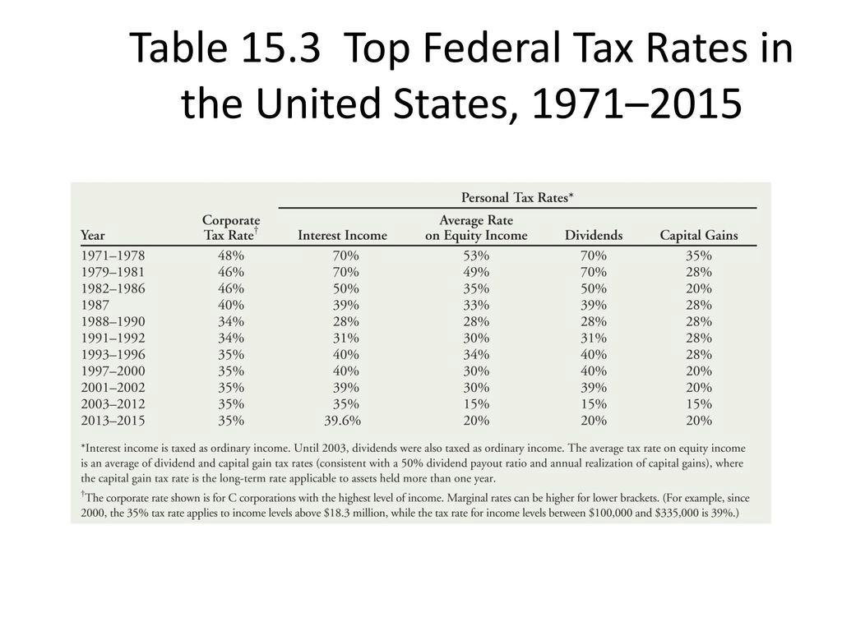
TABLE 15.3 Top Fedral Federal Tax Rates in the United States, 1971-2015
= (Dividends + Capital Gains) / 2

Slide 46
Including Personal Taxes in the Interest Tax Shield
Consider a firm with $1 of earnings before interest and taxes. The firm can:
pay this $1 to debt holders as interest
pay equity holders directly, with a dividend
by retaining earnings so that shareholders receive a capital gain

Slide 47
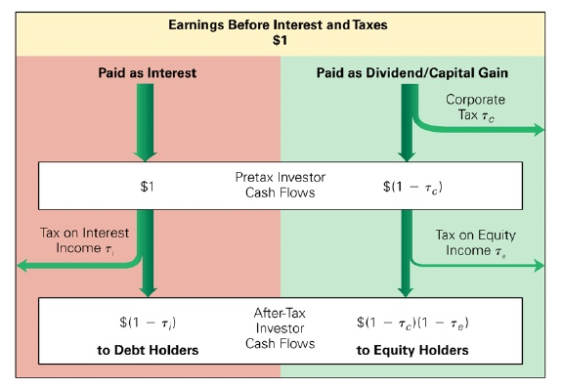
FIGURE 15.3 After-Tax Investor Cash Flows Resulting from $1 in EBIT

Slide 48
Combining corporate and personal rates leads to the following comparison: (using 2015 tax rates)
TABLE 15.3 Top Fedral Federal Tax Rates in the United States, 1971-2015
τ _{c}
τ _{i}
τ _{e}
 | After-Tax Cash Flows | Using Current Tax Rates
To debt holders | (1- τ_{i}) | (1 – 0.396) = 0.604
To equity holders | (1- τ_{c})(1- τ_{e}) | (1 – 0.35)(1 – 0.20) = 0.52

Slide 49
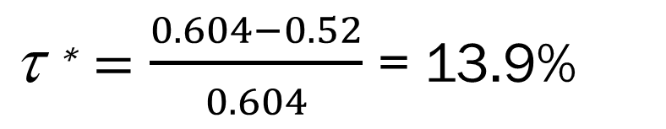
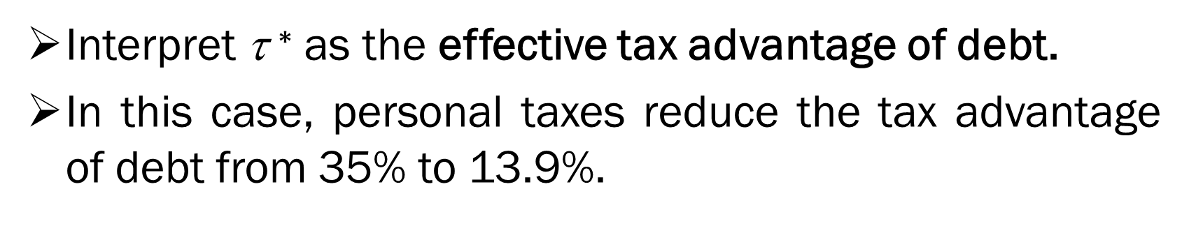
Combining corporate and personal rates leads to the following comparison: (using 2015 tax rates)
 | After-Tax Cash Flows | Using Current Tax Rates
To debt holders | (1- τ_{i}) | (1 – 0.396) = 0.604
To equity holders | (1- τ_{c})(1- τ_{e}) | (1 – 0.35)(1 – 0.20) = 0.52
Equity holders receive less after taxes than debt holders.
$\text{ }\text{∗}=\frac{0.604−0.52}{0.604}$ = 13.9%
Interpret τ $\text{∗}$ as the effective tax advantage of debt.
In this case, personal taxes reduce the tax advantage of debt from 35% to 13.9%.

Slide 50
Effective Tax Advantage of Debt
If the corporation paid (1 – τ *) in interest, debt holders would receive the same amount after taxes as equity holders would receive if the firm paid $1 in profits to equity holders.
debt holders
equity holders
(1 – 0.139)(1 – 0.396) = (1 – 0.35)(1 – 0.20)
(1 - τ *)(1 - τ _{i}) = (1 - τ _{c})(1 - τ _{e})
τ _{i} : marginal personal tax rate on income from debt
τ _{c} : marginal corporate tax rate
τ _{e} : marginal personal tax rate on income from equity

Slide 51
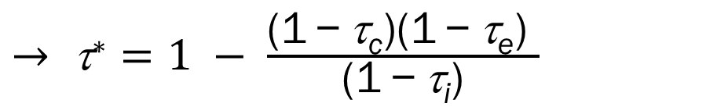
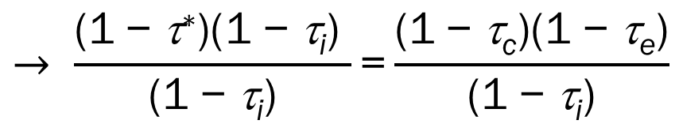
Effective Tax Advantage of Debt
Solving this equation for τ * gives
(1 - τ *)(1 - τ _{i}) = (1 - τ _{c})(1 - τ _{e})
Effective Tax Advantage of Debt
$$→ \frac{\text{(1} \text{−} \text{}\text{∗}\text{)(1} \text{−} \text{}\text{i}\text{) }}{\text{(1} \text{−} \text{}\text{i}\text{)}}\text{=}\frac{\text{(1} \text{−} \text{}\text{c}\text{)(1} \text{−} \text{}\text{e}\text{)}}{\text{(1} \text{−} \text{}\text{i}\text{)}}$$
$→ \text{τ}\text{∗}=1 − \frac{\text{(1} \text{−} \text{τ}\text{c}\text{)(1} \text{−} \text{τ}\text{e}\text{)} }{\text{(1} \text{−} \text{τ}\text{i}\text{)}}$
τ * : effective tax advantage of debt
τ _{i} : marginal personal tax rate on income from debt
τ _{c} : marginal corporate tax rate
τ _{e} : marginal personal tax rate on income from equity
Every $1 received after taxes by debt holders from interest payments costs equity holders $(1 – τ*) on an after-tax basis.

Slide 52
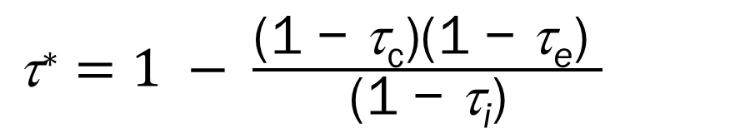
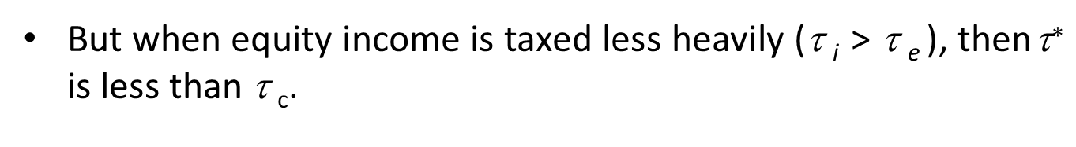
Effective Tax Advantage of Debt
When there are no personal taxes, or when the personal tax rates on debt and equity income are the same (τ _{i} = τ _{e} ), this formula reduces to
$\text{}\text{∗}=1 − \frac{\text{(1 − }\text{τ}\text{c}\text{)(1 − }\text{τ}\text{e}\text{)} }{\text{(1 − }\text{τ}\text{i}\text{)}}$
→ τ * = τ _{c}
But when equity income is taxed less heavily (τ _{i} > τ _{e} ), then $\text{}\text{∗}$ is less than τ _{c}.

Slide 53
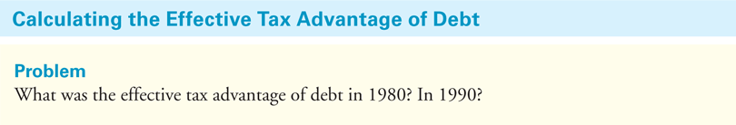
EXAMPLE 15.5
TABLE 15.3 Top Fedral Federal Tax Rates in the United States, 1971-2015

Slide 54
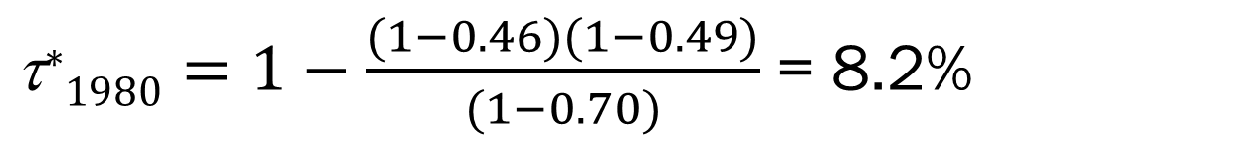
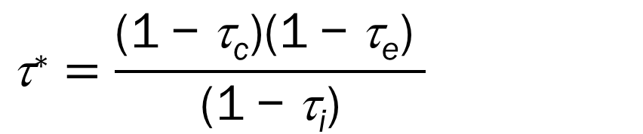
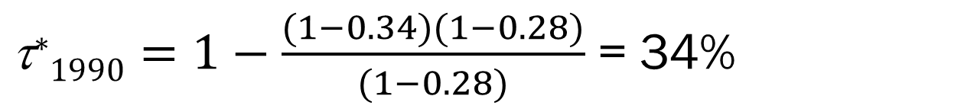
EXAMPLE 15.5 Calculating the Effective Tax Advantage of Debt
Solution:
$$\text{}\text{∗}=\frac{\text{(1} \text{−} \text{τ}\text{c}\text{)(1} \text{−} \text{τ}\text{e}\text{)} }{\text{(1} \text{−} \text{τ}\text{i}\text{)}}$$
τ_{i} > τ_{e} → τ * < τ _{c}
$\text{}\text{∗}1980=1−\frac{(1−0.46)(1−0.49)}{(1−0.70)}$ = 8.2%
τ_{i} = τ_{e} → τ * = τ _{c}
$\text{}\text{∗}1990=1−\frac{(1−0.34)(1−0.28)}{(1−0.28)}$ = 34%
Given the tax rates at the time, the effective tax advantage of debt was much lower in 1980 than in 1990.

Slide 55
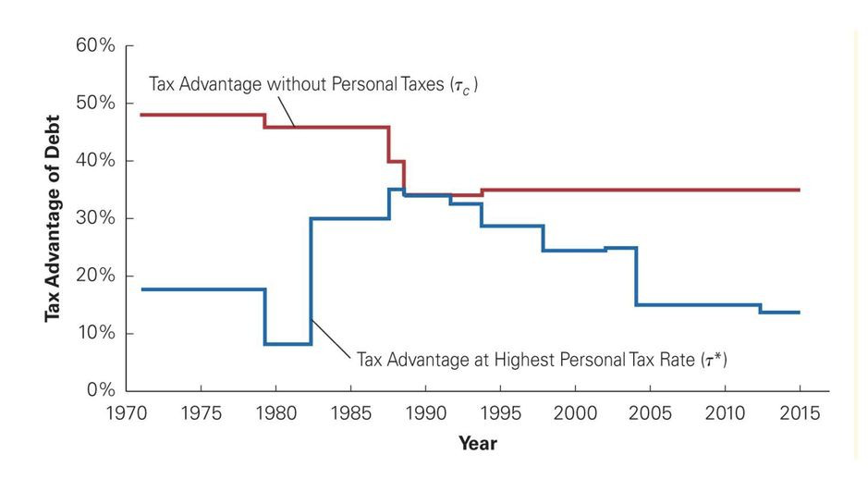
FIGURE 15.4 The Effective Tax Advantage of Debt with and without Personal Taxes, 1971-2015

Slide 56
Valuing the Interest Tax Shield with Personal Taxes
τ * > 0 → Despite any tax disadvantage of debt at the personal level, a net tax advantage for leverage remains.
With personal taxes and permanent debt, the value of the firm with leverage becomes
V ^{L} = V ^{U} + τ * D
V ^{L} : value of the firm with leverage
V ^{U} : value of the unlevered firm
τ * : effective tax advantage of debt
D: market value of debt

Slide 57
Valuing the Interest Tax Shield with Personal Taxes
Personal taxes have a similar, but indirect, effect on the firm's weighted average cost of capital.
We still compute the WACC as
With personal taxes, the firm’s equity and debt costs of capital will adjust to compensate investors for their respective tax burdens.

Slide 58
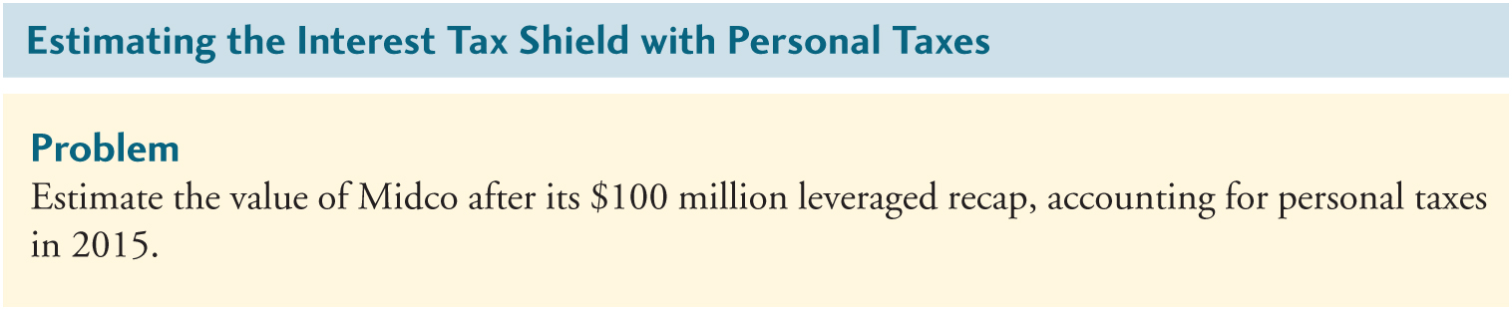
EXAMPLE 15.6
Midco Industries has 20 million shares outstanding with a market price of $15 per share.
TABLE 15.3 Top Fedral Federal Tax Rates in the United States, 1971-2015

Slide 59
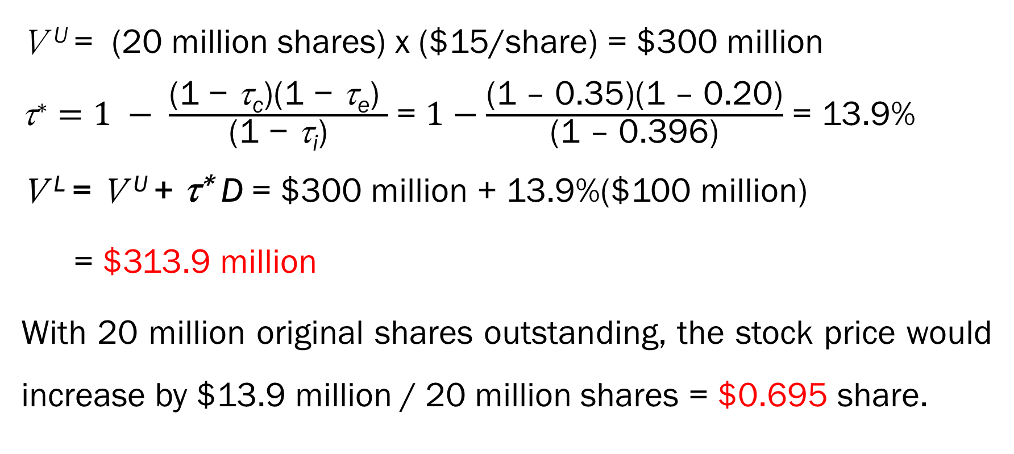
EXAMPLE 15.6 Estimating the Interest Tax Shield with Personal Taxes
Solution:
V ^{L} = V ^{U} + τ * D
V ^{U} = (20 million shares) x ($15/share) = $300 million
$\text{}\text{∗}=1 − \frac{\text{(1 − }\text{τ}\text{c}\text{)(1 − }\text{τ}\text{e}\text{)} }{\text{(1 − }\text{τ}\text{i}\text{)}}$ = $1−\frac{\text{(1 – 0.35)(1 – 0.20)}}{\text{(1 – 0.396)}}$ = 13.9%
V ^{L} = V ^{U} +$\text{}\text{∗ }$D = $300 million + 13.9%($100 million)
= $313.9 million
With 20 million original shares outstanding, the stock price would increase by $13.9 million / 20 million shares = $0.695 share.

Slide 60
Determining the Actual Tax Advantage of Debt
Several assumptions that may need adjustment when determining the actual tax benefit for a particular firm or investor.
capital gains tax rate
Assumed
Investors paid capital gains taxes every year.
In reality
Capital gains taxes are paid only at the time the investor sells the stock and realizes the gain.

Slide 61
Determining the Actual Tax Advantage of Debt
Deferring the payment of capital gains taxes lowers the present value of the taxes, which can be interpreted as a lower effective capital gains tax rate.
To example, given a capital gains tax rate of 20% and an interest rate of 6%, holding the asset for 10 more years lowers the effective tax rate this year to
(20%)/1.06¹⁰ = 11.2%.

Slide 62
Determining the Actual Tax Advantage of Debt
Investors with accrued losses that they can use to offset gains face a zero effective capital gains tax rate.
investors with longer holding periods of with accrued losses
face a lower tax rate on equity income
(decreasing the effective tax advantage of debt)

Slide 63
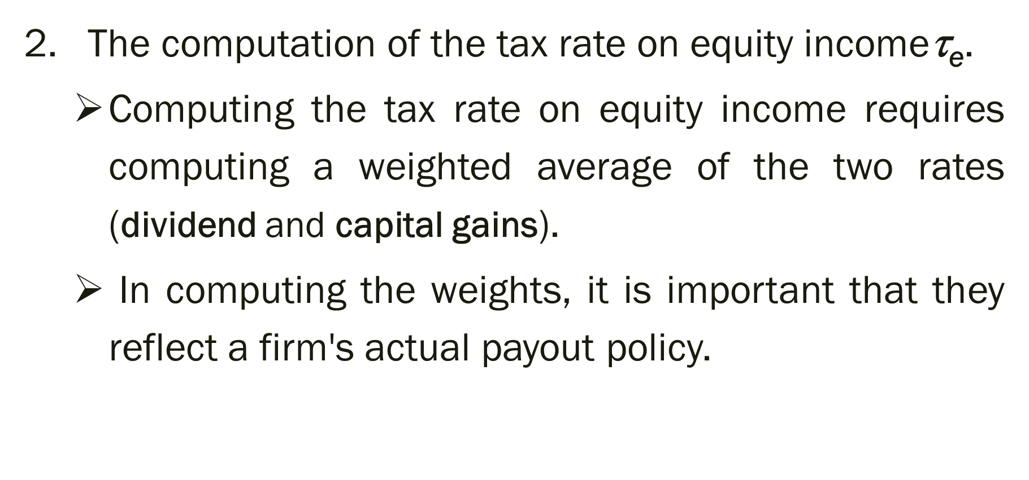
Determining the Actual Tax Advantage of Debt
The computation of the tax rate on equity incomeτ$\text{e}$.
Computing the tax rate on equity income requires computing a weighted average of the two rates (dividend and capital gains).
In computing the weights, it is important that they reflect a firm's actual payout policy.

Slide 64
Determining the Actual Tax Advantage of Debt
3.
Assumed
The top marginal federal income tax rates for the investor.
In reality
Rates vary for individual investors, and many investors face lower rates.
At lower rates, the effects of personal taxes are less substantial.

Slide 65
Determining the Actual Tax Advantage of Debt
Many investors face no personal taxes.
For example, investments held in retirement savings accounts or pension funds that are not subject to taxes.
For these investors, the effective tax advantage of debt is the full corporate tax rate.
→ τ* = τ_{c}

Slide 66
The bottom line
Calculating the effective tax advantage of debt accurately is extremely difficult.
A firm must consider
the tax bracket of its typical debt holders to estimate τ_{i} .
the tax bracket and holding period of its typical equity holders to determine τ_{e}.
While τ* is likely to be somewhat below τ_{c} , for the typical firm, exactly how much lower is open to debate.

Slide 67
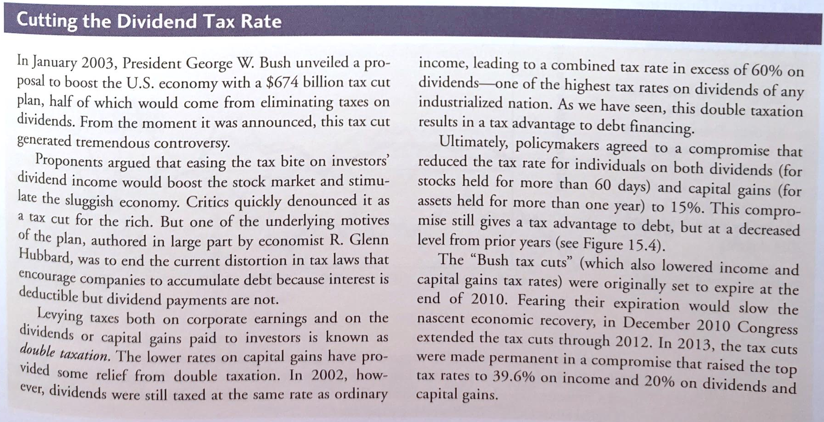
Cutting the Dividend Tax Rate

Slide 68
15.5 Optimal Capital Structure with Taxes

Slide 69
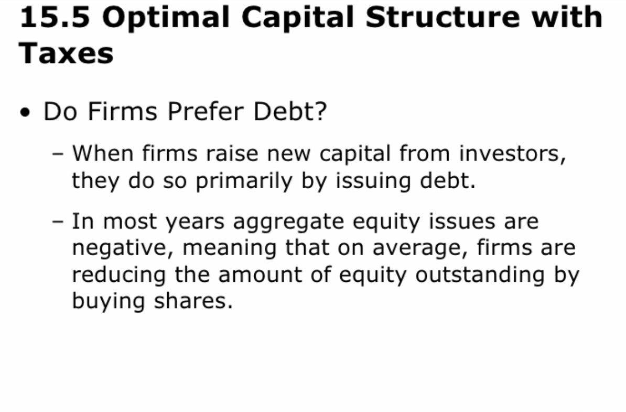

Slide 70
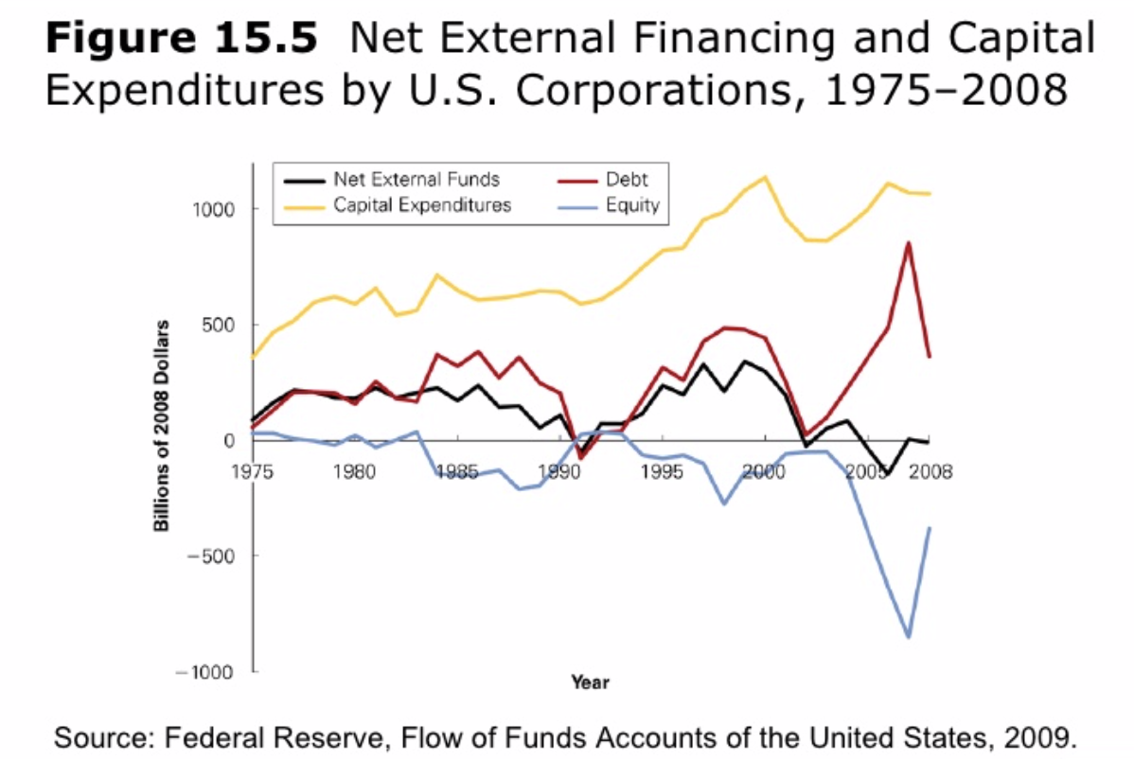
Notes:
資本支出大幅超過公司所取得的外部資金

Slide 71
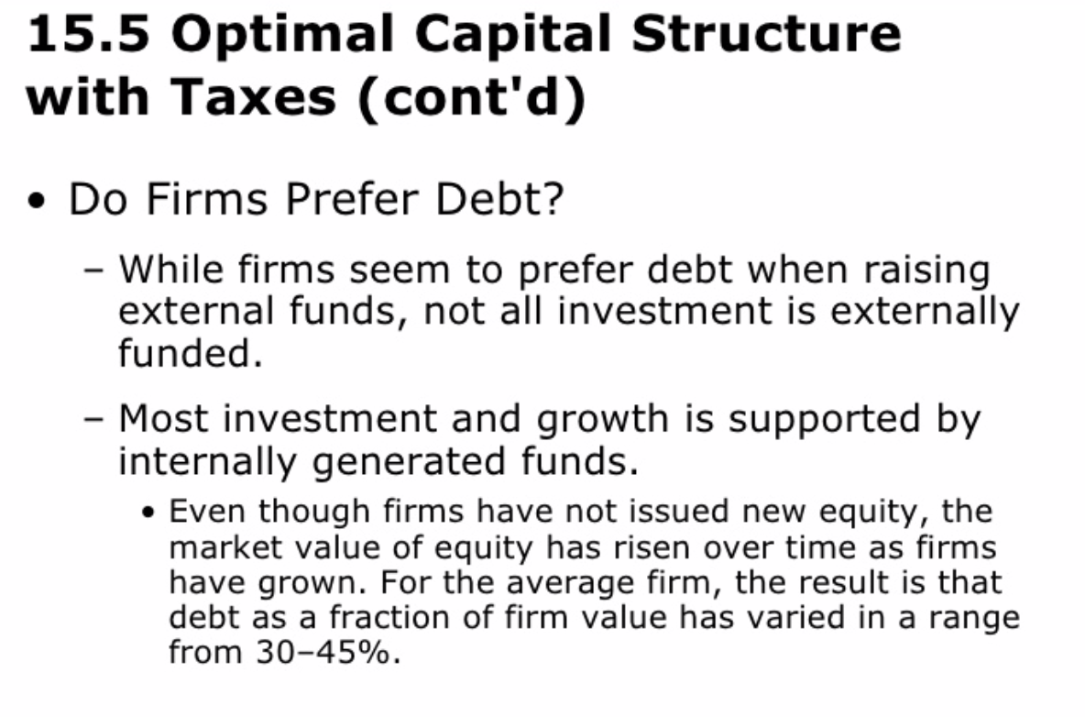

Slide 72
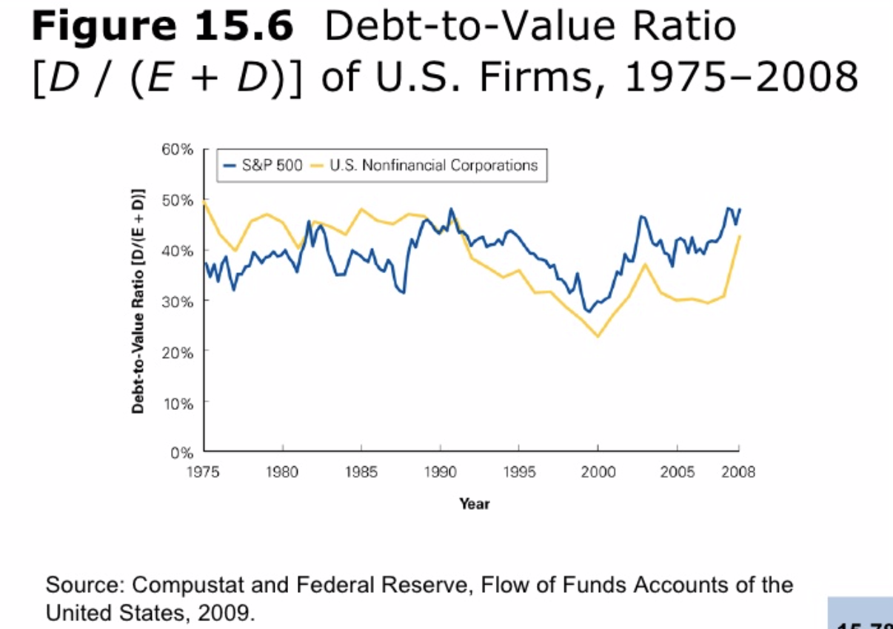
Notes:
平均負債價值比率在1990年代的多頭市場環境下呈現下降的趨勢，這個趨勢僅在2000年到2003年出現逆轉，當時股票市場與利率雙雙走低

Slide 73
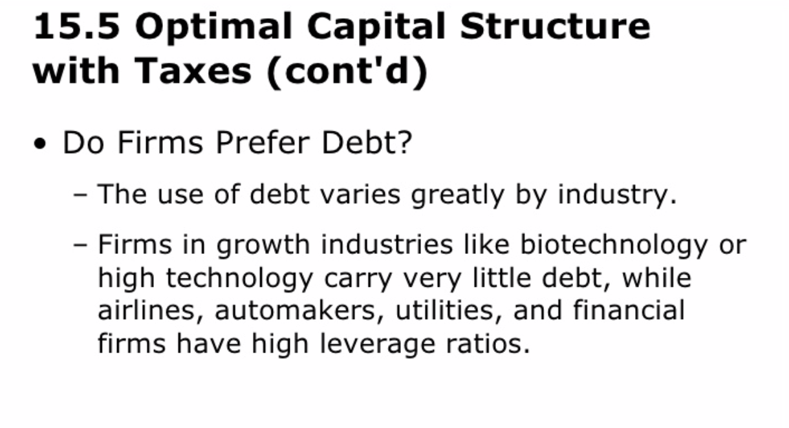
Notes:
1.產業間的負債使用程度是存在相當大的差異

Slide 74
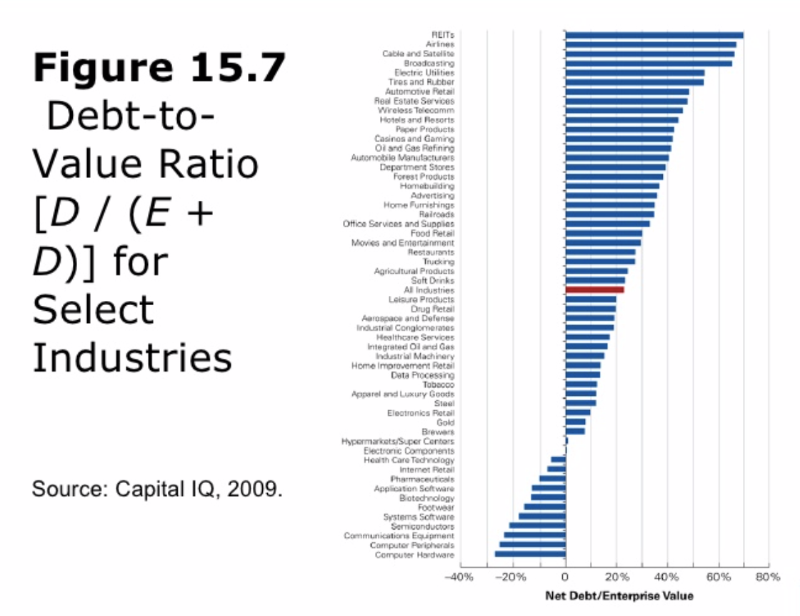
Notes:
部分產業與整體市場的負債價值比率
資料衍生出一些重要的問題，如果債務所提供的稅賦利益能 ↓降低公司的加權平均資金成本 並 ↑提高公司價值
為何大部分的公司負債佔資本結構的比例會低於一半?
為何產業間的槓桿決策會有如此大的差異?
→先從稅賦的觀點來觀察甚麼最適合資本結構

Slide 75
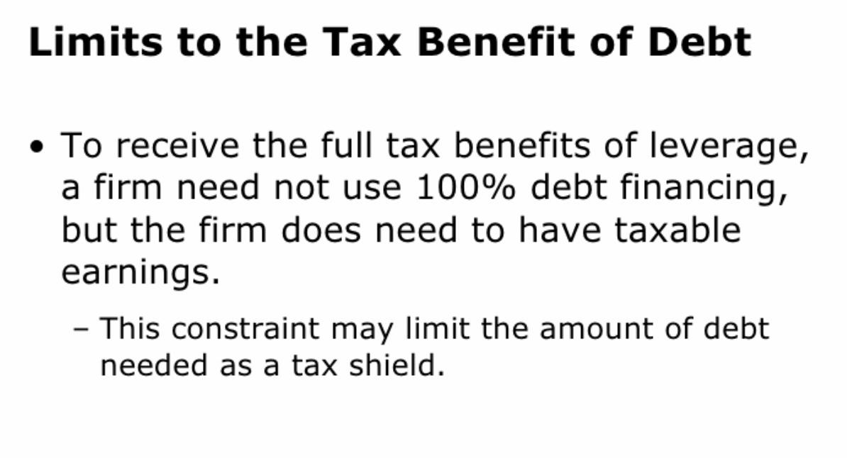

Slide 76
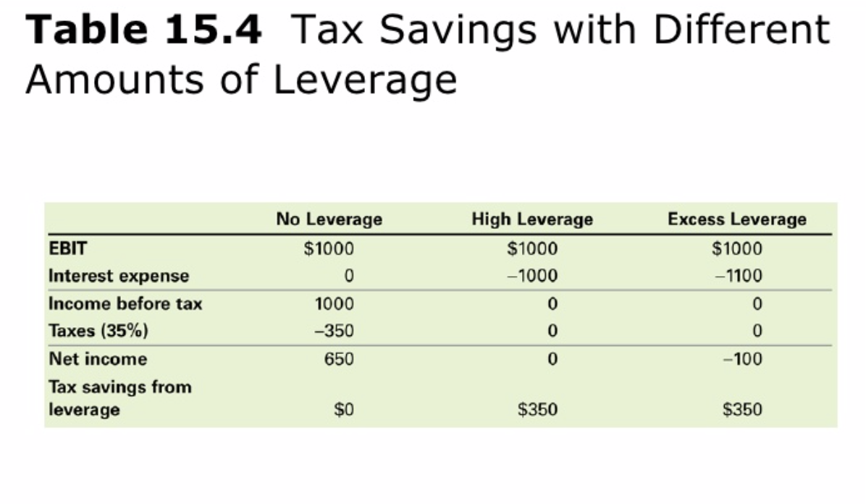
Notes:
假設公司的息前稅前盈餘為1000美元，公司的邊際稅率為35%

Slide 77
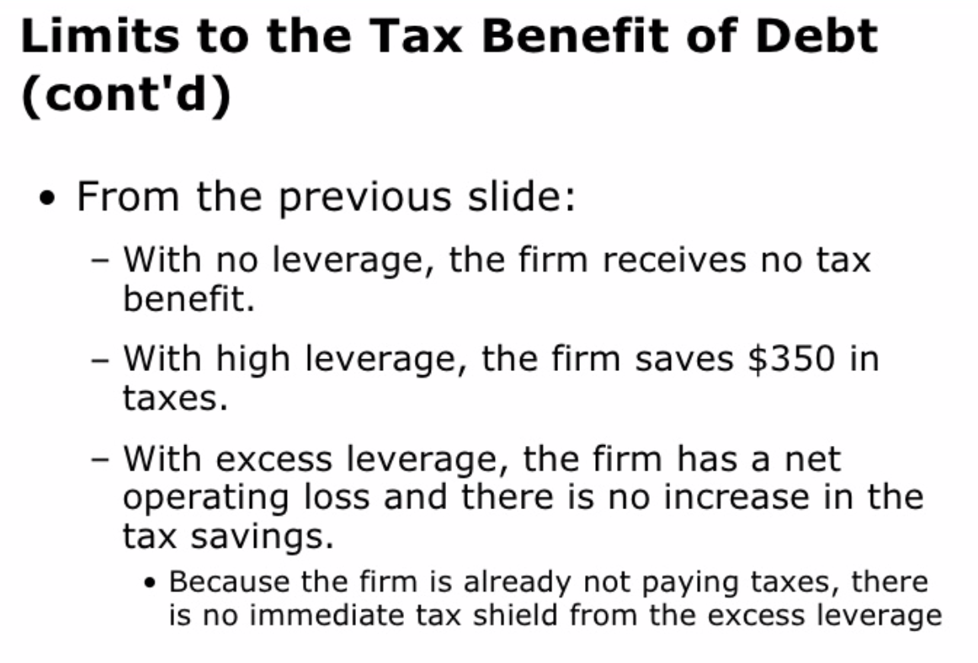

Slide 78
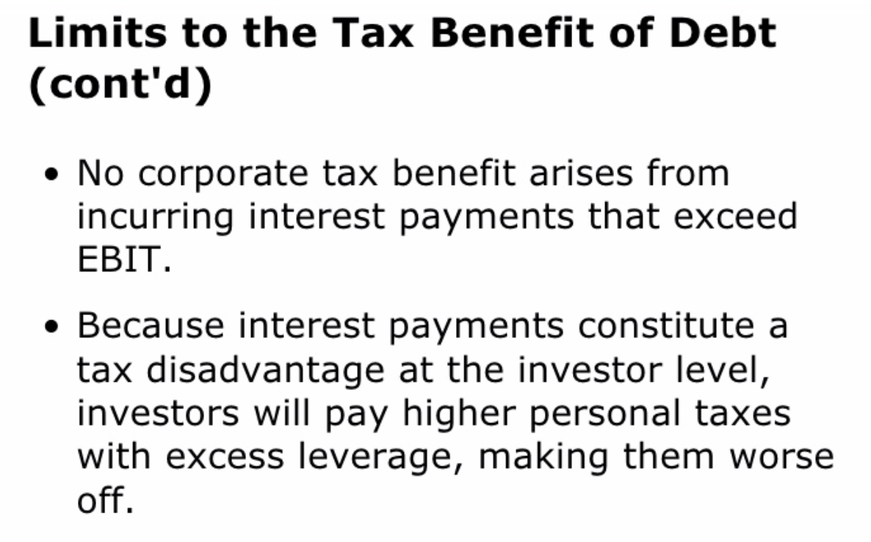

Slide 79
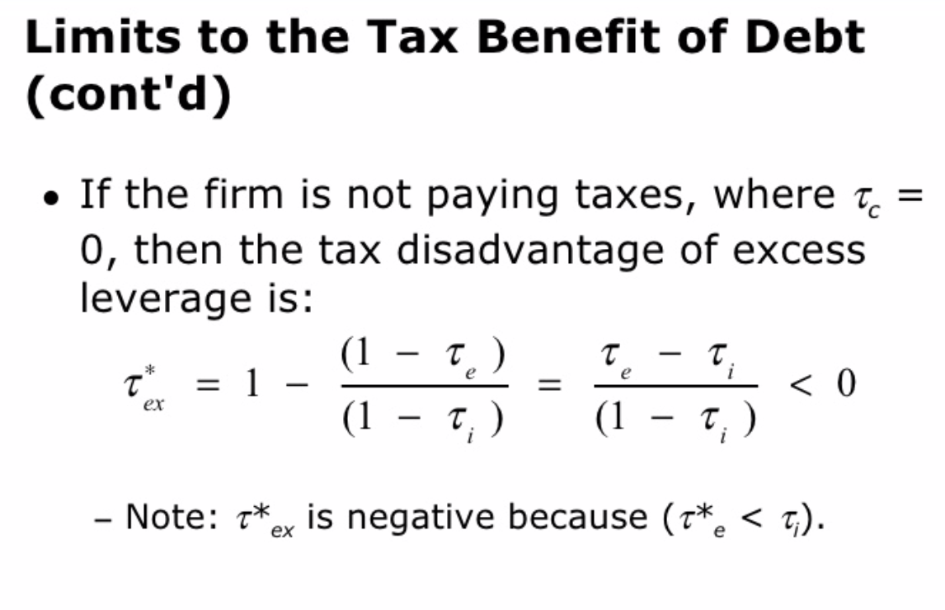
15 % - 35 %
- 30.8 %
35 %
Notes:
Tc=0 →假設過高的利息費用並無任何公司稅抵減的效果 ， 這種情況下的有效稅賦利益會變成 : 公式
Note: 由於投資人權益收入的稅率較利息收入的稅率低，所以Tex的質為負的。
以2005的稅賦資料為例，過度舉債所造成的損失為 -30.8%

Slide 80
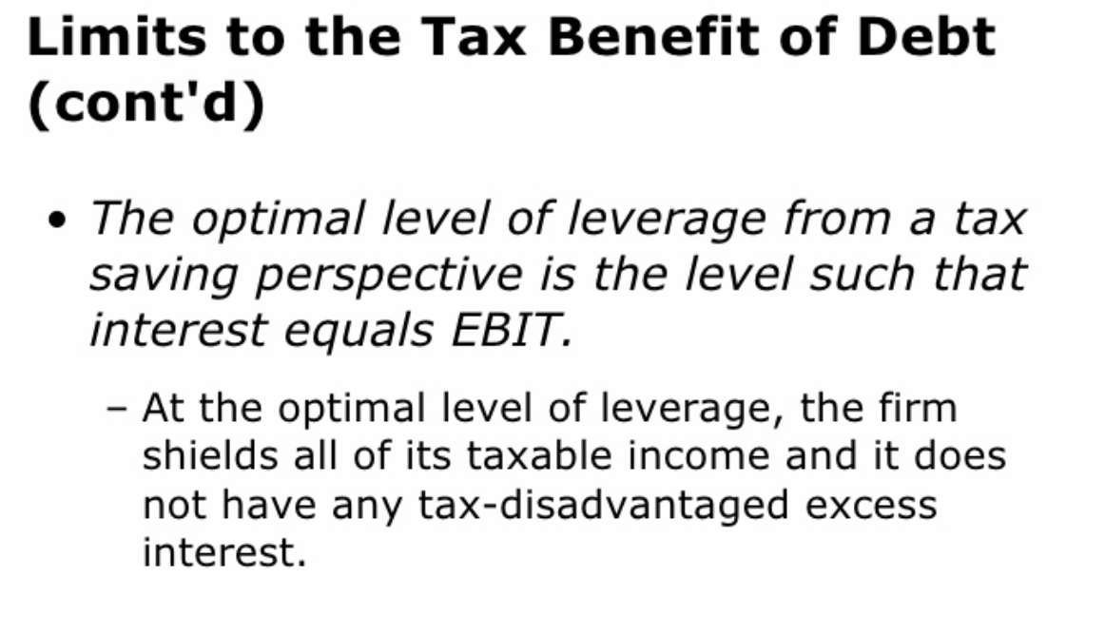
Notes:
在達到最佳槓桿程度時，利息費用等於息前稅前盈餘，節稅的金額達到最大。它沒有任何稅收減免的超額利息。

Slide 81
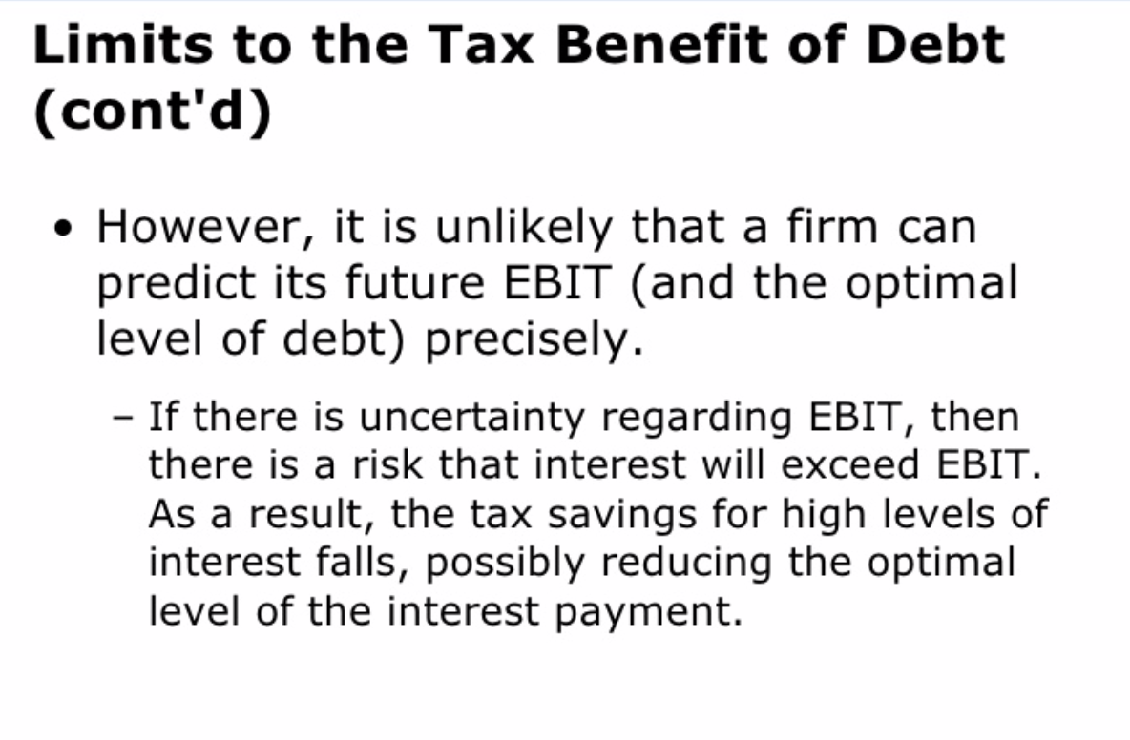

Slide 82
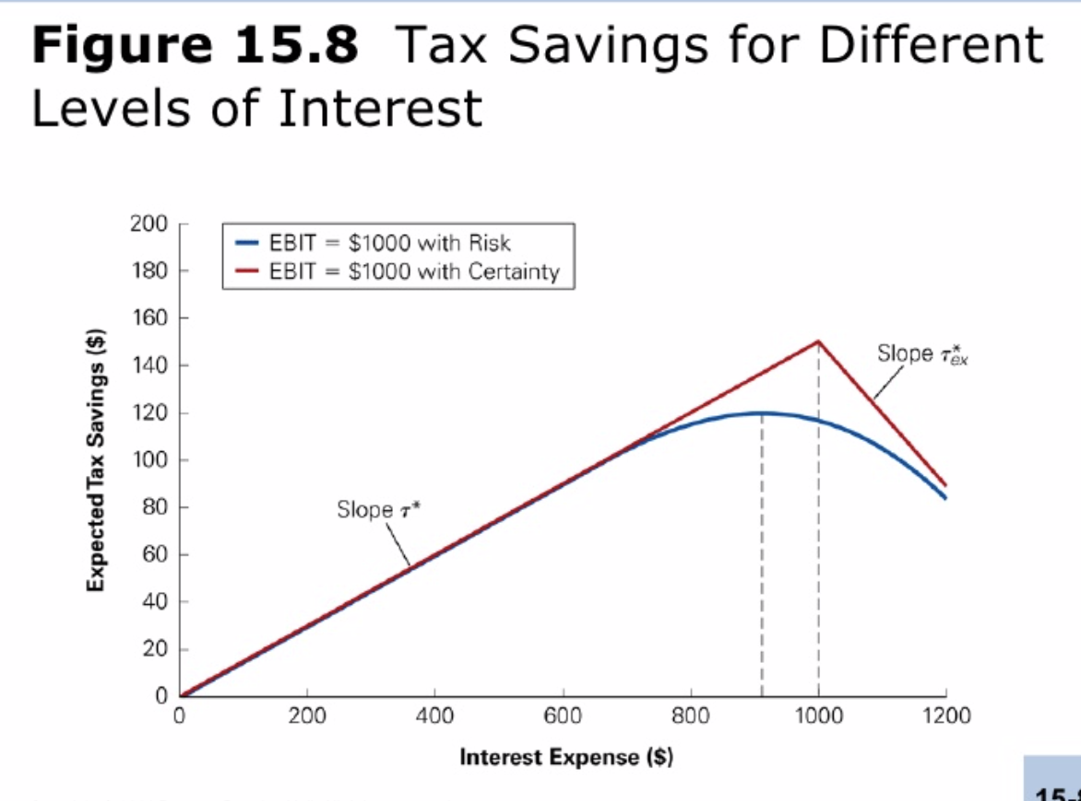

Slide 83
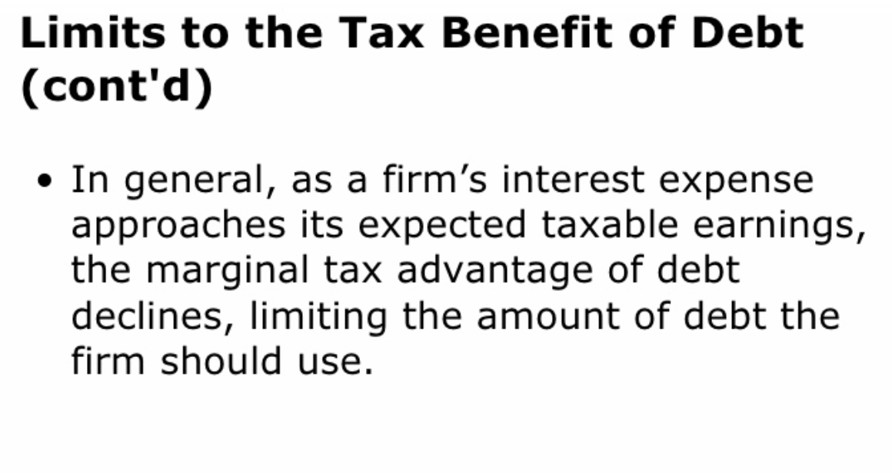

Slide 84
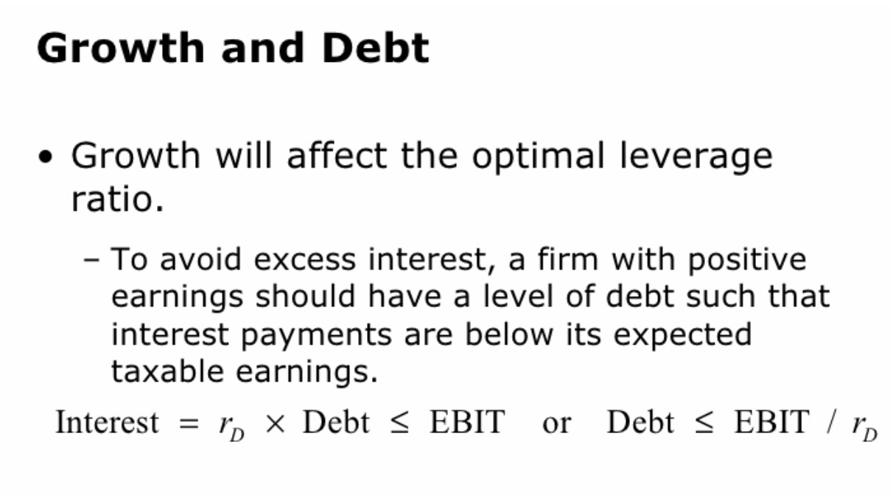
Notes:
(前) 在有稅賦考量下，估斯的最適資本結構中不應該含有負債。
(前) 到公司營運逐漸上軌道之後並且開始獲利之後，隨著課稅現金流量的產生，公司便可在資本結構中加入負債。

Slide 85


Slide 86

Notes:
如果公司具有其他稅收保護盾，則其應稅收入將減少，並且將減少對利息稅保護盾的依賴

Slide 87

Notes:
(反映債務有效稅收優勢的增加)

Slide 88

Notes:
公司利息費用與息前稅前盈餘對照

Slide 89


Slide 90


Slide 91


Slide 92


Slide 93


